Slide 1


Presented by Group B

Slide 2
Team Members
Michael Scheid
Project Manager/Software Engineer
Vincent Tran
Assistant Project Manager/Software Engineer
Ahmed Arbi
Software Engineer Frontend/Database
Benson Gao
Software Engineer Frontend/UX
Steven Duong
Software Engineer Frontend/UX
Eli Gomez
Test Engineer/Backend
Justin Terry
Test Engineer/Backend

Slide 3

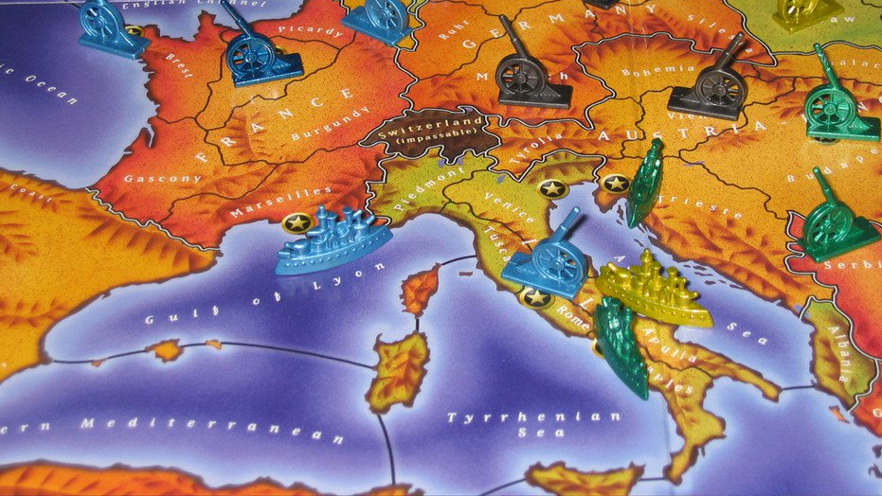



Recap: Taking Diplomacy Online.

Slide 4
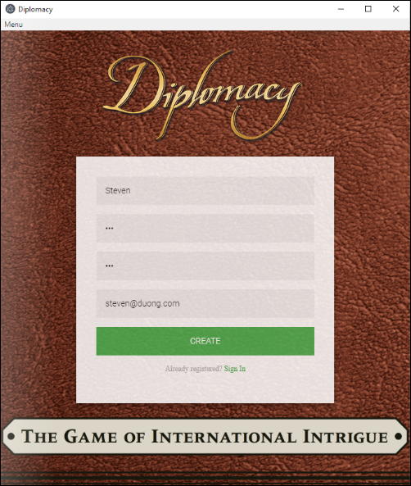
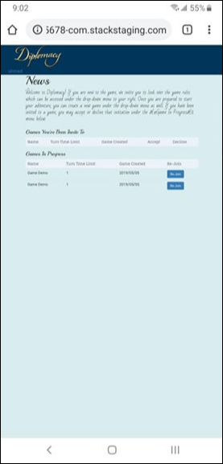
Initial Goals
Cross Platform
Game runs locally
Virtual Dashboard
Dynamic Map Interaction
Online Community
Low operating cost

Slide 5
Dynamic Interaction
Modified JQVMap Plugin
Resizable
Color Coded
Direct Interaction

Slide 6
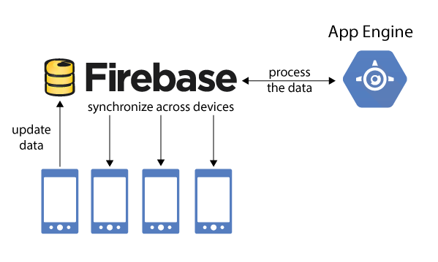
Game Logic
Front End Processing
Ensuring moves are valid.
Guide Players
Back End Processing
Validating user data.
Updating player’s position.

Slide 7
Game Play: Placing Orders

Slide 8
Game Logic: Decomposition
Front End
Dropdown System
DB changes trigger phase changes
Order Phase
Retreat Phase
Building Phase

Slide 9
Live Chat

Slide 10
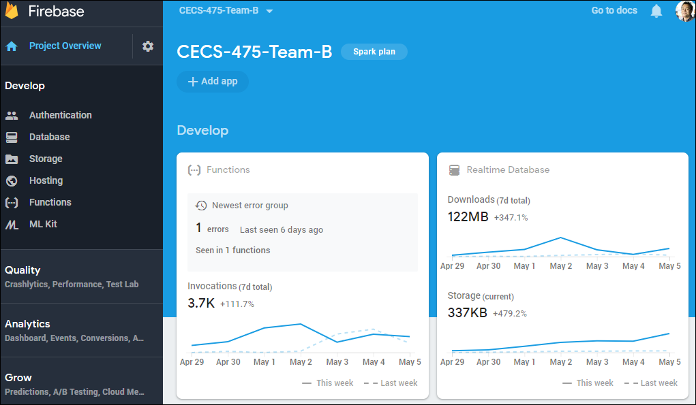
Effective and Flexible Backend
Fully adaptable based on current usage.
Pay as you go: Low deployment and scaling costs.
Cloud processing

Slide 11

In Development
Improve FireBase efficiency
Faster frontend processing
Continuous improvement of UI
Friends List
Game Finder
Bug squashing

Slide 12
Postmortem:
What we achieved
Overall Requirements
93.28% of Functional and Nonfunctional requirements achieved.
Functional Requirements
74% completed
Priority | Functional Requirements | Non-Functional Requirements
High | FN-01 to FN-06 FN-09 to FN-12 FN-14 to FN-17 | NFN-01 to NFN-03 NFN-05 NFN-08
Medium-High | FN-07 to FN-08 | NFN-04
Medium-Low | FN-18 to FN-20 | NFN-06 to NFN-07
Low |  | NFN-09
Priority Weights: High = 5, Med-High = 2, Med-Low = 1.5 and Low = 1
Status Weights: Green = 1, Yellow = 0.5, Red = 0
Requirements Total = 108
Total completed = 74 (FN) + 26.75 (NFN) = 100.75

Slide 13
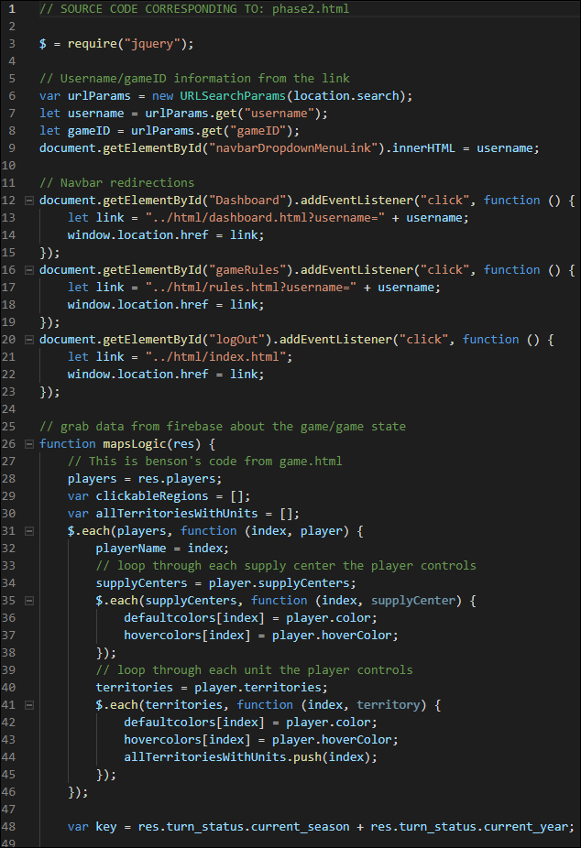
Postmortem: Unobtained Goals
User Interface:
Not mobile friendly
Limited statistical data
Backend Processing
Recursive round resolution vs Greedy.
Game Logic
Convoying

Slide 14
Postmortem: Future Improvements
More UI iterations
Prototyping
More Efficient Architecture
More Front End processing.
More accurate decomposition of game logic
Additional time for testing

